Slide 1




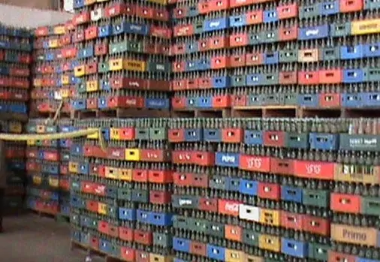
Manufacturing Downtime Analysis

Slide 2
Manufacturing Downtime Analysis Digital Egypt Pioneers Initiative (DEPI) Google Data Analysis Specialist Track (Round 2) CAI2_DAT1_G6 November 2024 – April 2025

Slide 3




Contributors: Abd Al-Rahman Mohamed Amin Mohamed Shebl Azab Omar Mohamed Shebl Ahmed Mohamed "Project supervised by: Eng. Ahmed Samir"

Slide 4
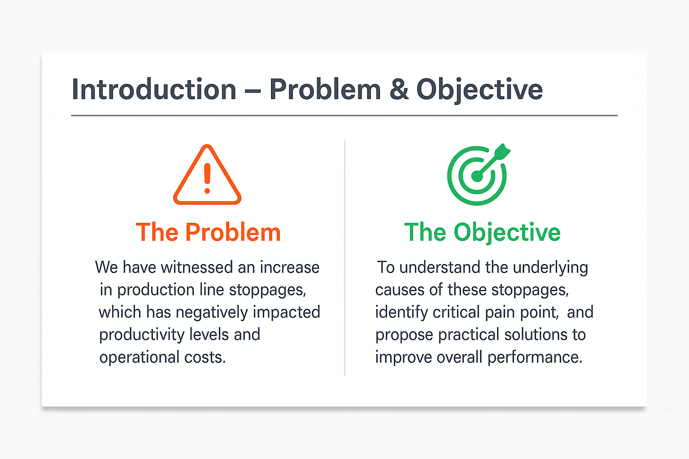


Slide 5
Agenda :
Project Overview
Data transformation
Key Metrics at a Glance
Root Cause Analysis
Time-Based Trends
Operator & Product Impact
Forecasting
Actionable Recommendations

Slide 6
Project Overview
Objective:
Identify key factors causing downtime and propose solutions to enhance productivity
Minimize unplanned downtime to improve OEE(Overall Equipment Effectiveness)
Scope:
5 days of production data.
Analyzed 12 downtime factors across 6 products and 4 operators.
Evaluated 88 hours of production time (23 hours downtime).

Slide 7
Data Transformation & Preparation (Unpivoting Data)
Key Issues Resolved
Normalized Line Downtime table from wide to long format (1NF violation).
Separated Min Batch Time and Size into a new table (3NF violation).
Fixed inconsistent End Time data types (1 anomaly corrected).
Tools Used:
Excel Power Query, Python (Pandas, NumPy).

Slide 8
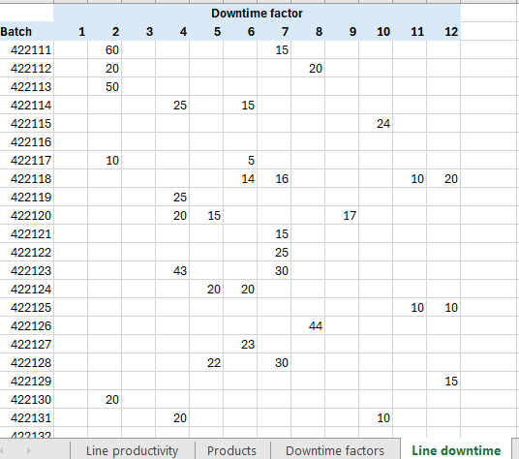
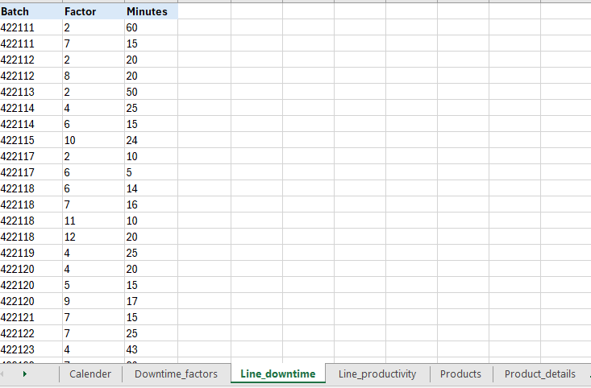
Visual: Before/After table snippets.

Slide 9



Data Preparation & loading :
Python was used to ensure that each table was clean and ready for analysis:
Check for missing values: No value was found to be missing in any of
the tables.
Check that the number of unique IDs is equal to the number of rows in
the table: all rows were found to have unique IDs in all the tables.
Check for duplicate records: no duplicate records were found in any
of the tables.

Slide 10
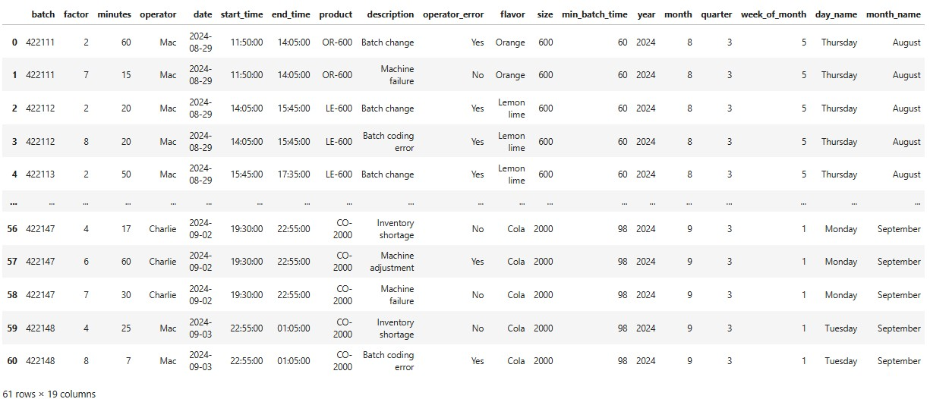
Data Preparation & loading :

Slide 11
Data Modelling :
Microsoft Excel Power Pivot was used to construct a calendar table,
and build a relational model to ensure efficient querying and
visualization. The following entity relationship diagram (ERD)
Summarizes all the relations in the model:

Slide 12
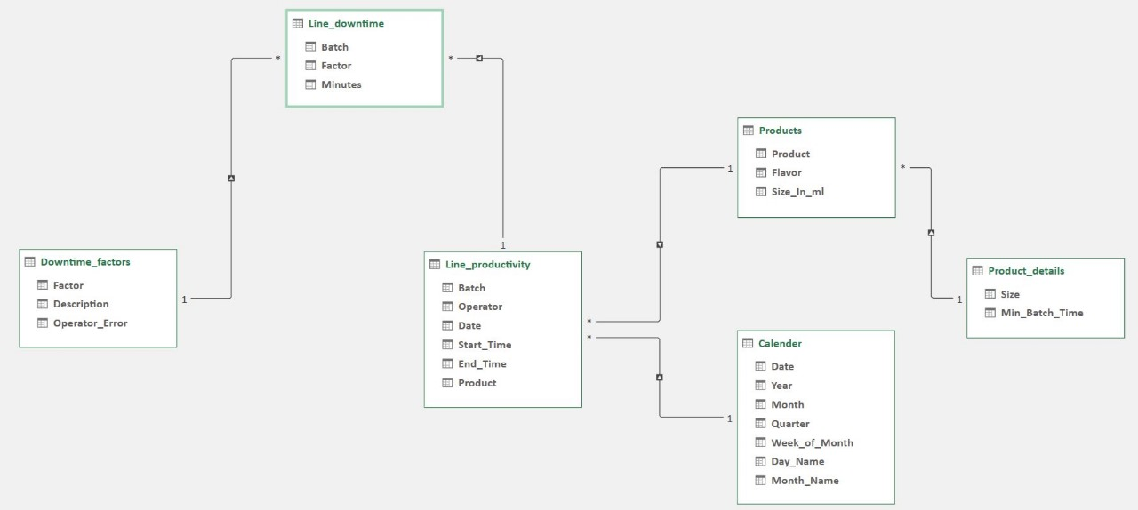
Data Modelling :

Slide 13
Tools and Technologies Used :
Microsoft Excel (Power Query , Power Pivot ).
Python (packages: Pandas, NumPy, and datetime).
Microsoft SQL Server.
Tableau

Slide 14
Key Metrics at a Glance
Total Downtime: 23 hours (26.2% of total work time).
Avg. Daily Downtime: 277.6 minutes.

Slide 15
Analysis Questions :
Cause Analysis
Time Analysis
Impact Analysis

Slide 16
Cause Analysis :
Which factors are most associated with downtime?
Are some downtime factors more frequent than others?
Does operator error cause more downtime than other causes?
Which operator causes more downtime and through which factors?
Does downtime occur at higher rates for in products with certain flavors?
How does product size impact the occurrence of downtime?
Does product spill occur more often with products of large volume?
Which products experience more downtime?

Slide 17
Root Cause Analysis
Main Causes:
Operator Error: 55.91%
Non_Operator Error : 44.09%

Slide 18
Top 5 Contributors Factors to downtime :
Machine Adjustment (332 min).
Machine Failure (254 min).
Inventory Shortage (225 min).
Batch change (160 min).
Batch coding error (145 min).

Slide 19
Operator Performance
Charlie: 384 min.
Dee: 370 min.
Mac: 332 min .
Dennis: 302 min .

Slide 20
Time Analysis :
How does downtime vary overtime?
How does downtime vary by work shifts?
How much production time was lost due to downtime?

Slide 21
Time-Based Downtime Trends
Peak Downtime:
647 minutes on August 29 (Shift 1).
Sep 2: Highest operator-related downtime (Dee: 370 min).
Daily Trend: Line graph showing downtime spikes from Aug 29 – Sep 3.

Slide 22
Impact Analysis :
How does down time impact productivity?

Slide 23
Product & Batch Impact
Product-Specific Issues:
CO-600 (Cola): Highest downtime (Batch 422123: 73 min).
RB-600 (Root Berry): Frequent labeling errors.
Batch Size Impact:
CO-2000: 98 min/batch vs. 600ml: 60 min/batch.

Slide 24
Visualization and Final Presentation :
The project data analysis was prepared through the Tableau
visual data tool and displayed on two dashboards:
Downtime Cause Analysis
Downtime Time Series Analysis

Slide 25
Forecasting
Forecasting Questions :
1. How is downtime expected to change within the next day of operation?
2. How many batches will be produced in the next day of operation?

Slide 26
Recommendations
Immediate Actions:
Train operators on machine calibration (reduce 55.91% human error).
Implement preventive maintenance for critical machines.
Mid-Term:
Optimize inventory alerts to prevent shortages.
Redesign labeling workflows (e.g., automated checks).

Slide 27
Long-Term:
Invest in production line spare parts that can be installed when
switching production to different flavors to avoid having to clean
to avoid contamination.
Upgrade machinery software to introduce the preset setting Feature
which reduces operator involvement with machine adjustments
and changing machine settings for batch changes.
upgrade to IoT-enabled machines for real-time diagnostics.
Monthly KPI tracking to measure progress.

Slide 28
References :
Final Excel Data
Python Jupyter notebook
SQL Server
Tableau
The documentation

Slide 29

Acknowledgments:
Gratitude to the Ministry of Communications and IT:
We extend our deepest thanks to the Ministry of Communications and
Information Technology for their visionary leadership in advancing
Egypt’s digital transformation and empowering youth through
world-class initiatives.

Slide 30

Acknowledgments:
Digital Egypt Pioneers Initiative (DEPI):
Special acknowledgment to the DEPI management team for designing
and delivering this exceptional training program. Your commitment to
nurturing data-driven professionals has equipped us with cutting-edge
skills to tackle real-world challenges.

Slide 31
Acknowledgments:
Collaborators & Supporters:
To everyone who contributed to building this initiative’s
ecosystem—mentors, trainers, and administrators—your efforts
have created a transformative learning experience , including :
Technical company: I Learn & EYouth
non-technical company: EYouth
coaching company: El Harefa
English company: Berlitz
Non-technical instructor: Eng. Hesham Elgendy
Coaching instructor: Eng. Diaa Samir

Slide 32
Acknowledgments:
Special Thanks to Eng. Ahmed Samir:
Our sincere appreciation to Eng. Ahmed Samir for his unwavering
support, technical guidance, and dedication to ensuring the success
of this project. His expertise and patience were invaluable in
shaping this analysis.

Slide 33


Closing Note:
This project reflects the collective impact of Egypt’s digital upskilling
efforts. We wish continued success to the Ministry, DEPI,
and all future pioneers!
Abd Al-Rahman Mohamed
Mohamed Shebl
Omar Mohamed
Ahmed Mohamed
GitHub

Slide 34


